Slide 1
Comparisons Between Two Populations

Slide 2
Paired Observations

Slide 3
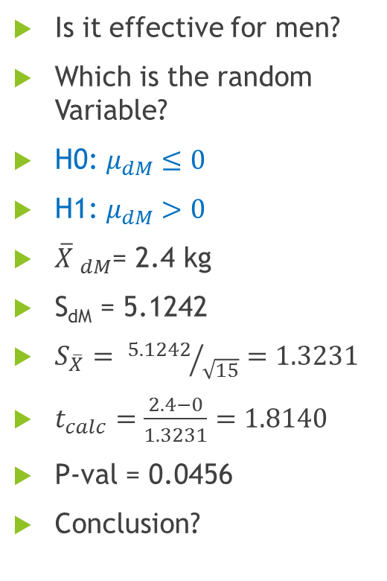
Chubby Chunky – 1 Matched Samples
Sl. No. | Before | After
1 | 72 | 68
2 | 84 | 78
3 | 83 | 75
4 | 96 | 92
5 | 78 | 86
6 | 83 | 79
7 | 102 | 95
8 | 74 | 72
9 | 82 | 81
10 | 80 | 87
11 | 88 | 83
12 | 76 | 74
13 | 79 | 72
14 | 70 | 75
15 | 91 | 85
Difference
4
6
8
4
-8
4
7
2
1
-7
5
2
7
-5
6
Is it effective for men?
Which is the random Variable?
H0: $μ_{dM}≤0$
H1: $μ_{dM}>0$
$\overline{X} _{dM}$= 2.4 kg
S_{dM} = 5.1242
$S_{\overline{X}}= {5.1242}/{\sqrt{15}}=1.3231$
$t_{calc}=\frac{2.4−0}{1.3231}=1.8140$
P-val = 0.0456
Conclusion?

Slide 4
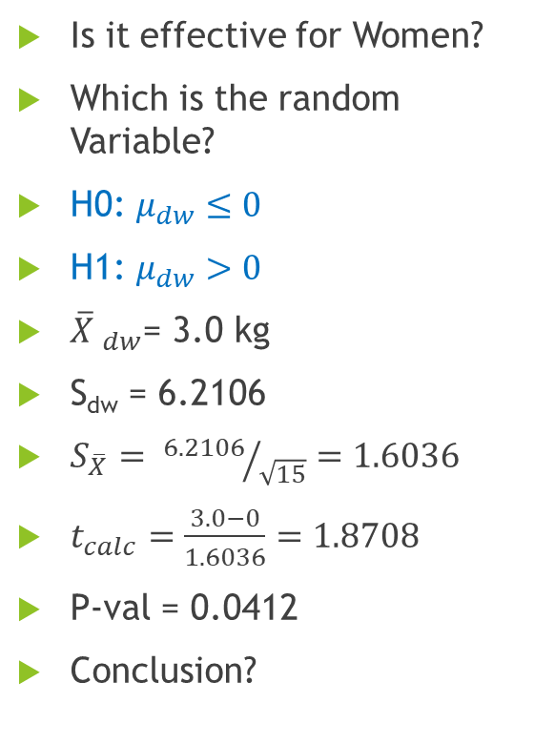
Chubby Chunky – 1 Matched Samples
Sl. No. | Before | After
1 | 98 | 92
2 | 89 | 84
3 | 76 | 65
4 | 84 | 77
5 | 87 | 95
6 | 93 | 88
7 | 90 | 84
8 | 79 | 76
9 | 81 | 77
10 | 68 | 77
11 | 74 | 70
12 | 70 | 66
13 | 103 | 94
14 | 72 | 80
15 | 79 | 73
Difference
6
5
11
7
-8
5
6
3
4
-9
4
4
9
-8
6
Is it effective for Women?
Which is the random Variable?
H0: $μ_{dw}≤0$
H1: $μ_{dw}>0$
$\overline{X} _{dw}$= 3.0 kg
S_{dw} = 6.2106
$S_{\overline{X}}= {6.2106}/{\sqrt{15}}=1.6036$
$t_{calc}=\frac{3.0−0}{1.6036}=1.8708$
P-val = 0.0412
Conclusion?

Slide 5
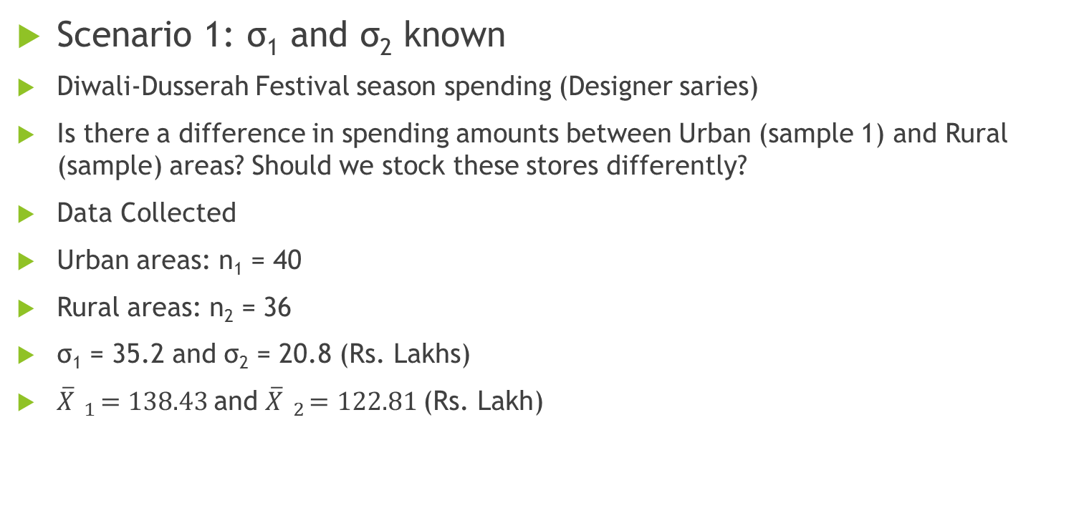
Difference between Two Population Means with Independent Samples
Scenario 1: σ₁ and σ₂ known
Diwali-Dusserah Festival season spending (Designer saries)
Is there a difference in spending amounts between Urban (sample 1) and Rural (sample) areas? Should we stock these stores differently?
Data Collected
Urban areas: n₁ = 40
Rural areas: n₂ = 36
σ₁ = 35.2 and σ₂ = 20.8 (Rs. Lakhs)
$\overline{X} _{1}=138.43$and $\overline{X} _{2}=122.81$(Rs. Lakh)

Slide 6
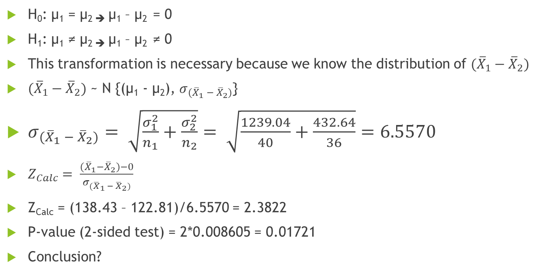
Hypothesis test
H₀: µ₁ = µ_{2 ➔} µ₁ – µ₂ = 0
H₁: µ₁ ≠ µ_{2 ➔} µ₁ – µ₂ ≠ 0
This transformation is necessary because we know the distribution of $({\overline{X}}_{1}−{\overline{X}}_{2})$
$({\overline{X}}_{1}−{\overline{X}}_{2})$ ~ N {(µ₁ - µ₂), $σ_{{(\overline{X}}_{1} − {\overline{X}}_{2})}$}
$σ_{{(\overline{X}}_{1} − {\overline{X}}_{2})}= \sqrt{\frac{σ_{1}^{2}}{n_{1}}+\frac{σ_{2}^{2}}{n_{2}}}= \sqrt{\frac{1239.04}{40}+\frac{432.64}{36}}=6.5570$
$Z_{Calc}= \frac{({\overline{X}}_{1}−{\overline{X}}_{2})−0}{σ_{{(\overline{X}}_{1} − {\overline{X}}_{2})}}$
Z_{Calc} = (138.43 – 122.81)/6.5570 = 2.3822
P-value (2-sided test) = 2*0.008605 = 0.01721
Conclusion?

Slide 7
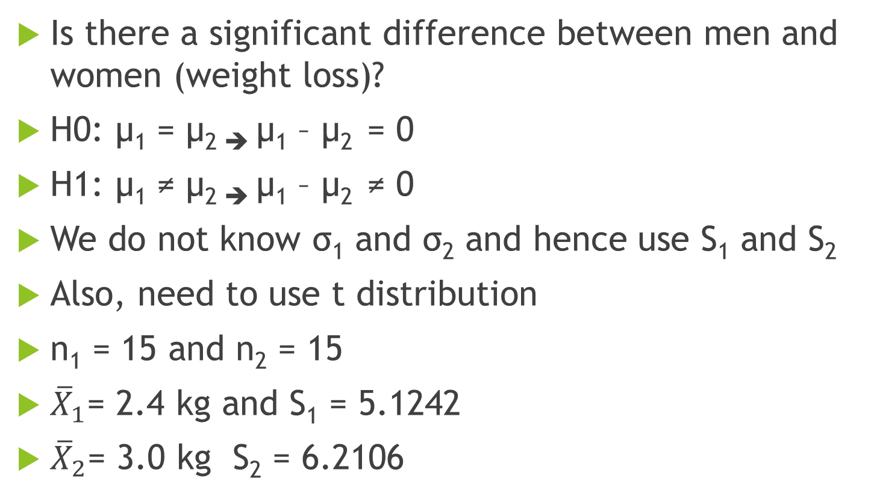
Chubby Chunky - 2
Is there a significant difference between men and women (weight loss)?
H0: µ₁ = µ_{2 ➔} µ₁ – µ₂ = 0
H1: µ₁ ≠ µ_{2 ➔} µ₁ – µ₂ ≠ 0
We do not know σ₁ and σ₂ and hence use S₁ and S₂
Also, need to use t distribution
n₁ = 15 and n₂ = 15
${\overline{X}}_{1}$= 2.4 kg and S₁ = 5.1242
${\overline{X}}_{2}$= 3.0 kg S₂ = 6.2106

Slide 8

Difference between Two Population Means with Independent Samples
Scenario 2: σ₁ and σ₂ NOT known
Two Possibilities:
σ₁ = σ₂ = σ
σ₁ ≠ σ₂
Consider the first one i.e., σ₁ = σ₂ = σ
$$S_{1}^{2}$$
$$S_{2}^{2}$$
σ²

Slide 9
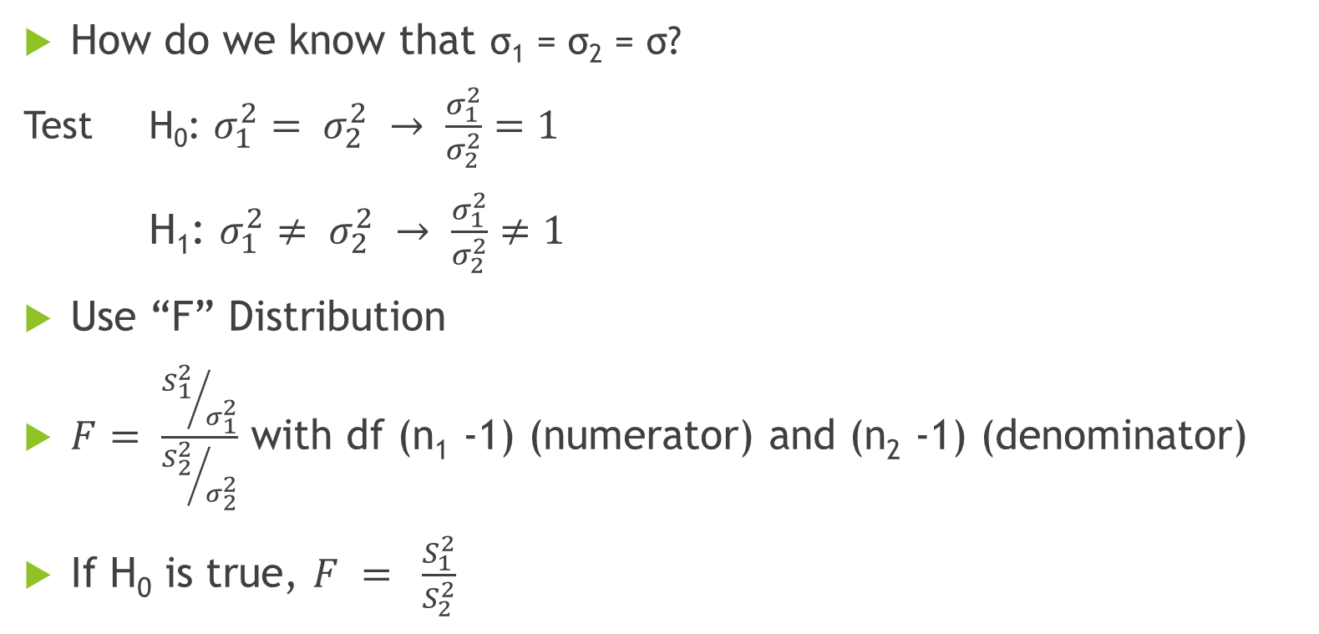
Test for Equality of Variances
How do we know that σ₁ = σ₂ = σ?
Test H₀: $σ_{1}^{2}= σ_{2}^{2} → \frac{σ_{1}^{2}}{σ_{2}^{2}}=1$
H₁: $σ_{1}^{2}≠ σ_{2}^{2} → \frac{σ_{1}^{2}}{σ_{2}^{2}}≠1$
Use “F” Distribution
$F= \frac{{S_{1}^{2}}/{σ_{1}^{2}}}{{S_{2}^{2}}/{σ_{2}^{2}}}$ with df (n₁ -1) (numerator) and (n₂ -1) (denominator)
If H₀ is true, $F = \frac{S_{1}^{2}}{S_{2}^{2}}$

Slide 10
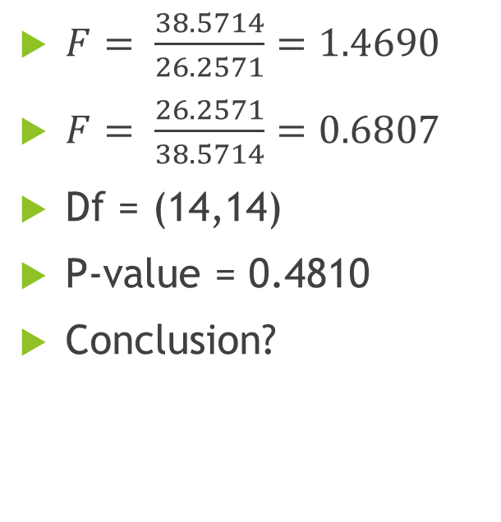
The F Test
$F= \frac{38.5714}{26.2571}=1.4690$
$F= \frac{26.2571}{38.5714}=0.6807$
Df = (14,14)
P-value = 0.4810
Conclusion?
0.2405
0.2405
0.6807
1.4690

Slide 11
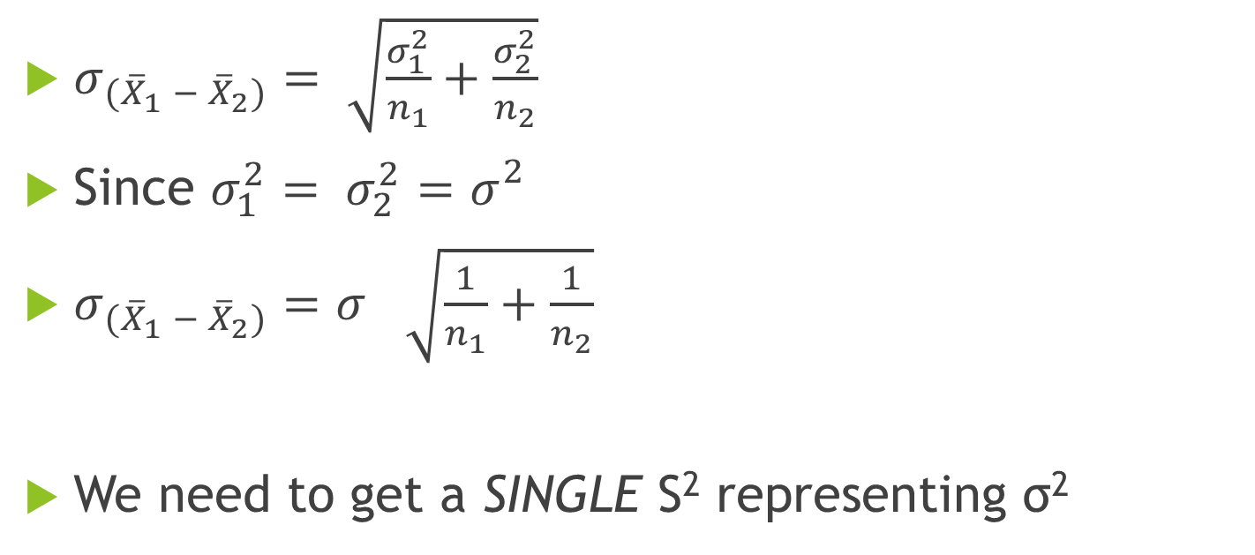
Standard Error
$σ_{{(\overline{X}}_{1} − {\overline{X}}_{2})}= \sqrt{\frac{σ_{1}^{2}}{n_{1}}+\frac{σ_{2}^{2}}{n_{2}}}$
Since $σ_{1}^{2}= σ_{2}^{2}=σ_{}^{2}$
$σ_{{(\overline{X}}_{1} − {\overline{X}}_{2})}=σ_{ }^{}\sqrt{\frac{1}{n_{1}}+\frac{1}{n_{2}}}$
We need to get a SINGLE S² representing σ²

Slide 12
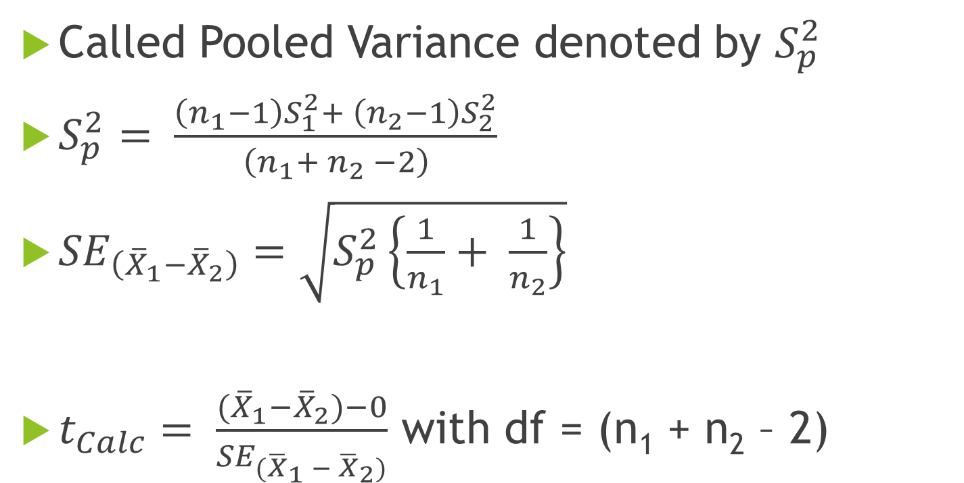
Combine the Two Sample Variances!
Called Pooled Variance denoted by $S_{p}^{2}$
$S_{p}^{2}= \frac{\left(n_{1}−1\right)S_{1}^{2}+ \left(n_{2}−1\right)S_{2}^{2}}{\left(n_{1}+ n_{2} −2\right)}$
${SE}_{\left({\overline{X}}_{1}−{\overline{X}}_{2}\right)}=\sqrt{S_{p}^{2}\left\{\frac{1}{n_{1}}+ \frac{1}{n_{2}}\right\}}$
$t_{Calc}= \frac{({\overline{X}}_{1}−{\overline{X}}_{2})−0}{{SE}_{{(\overline{X}}_{1} − {\overline{X}}_{2})}}$ with df = (n₁ + n₂ – 2)

Slide 13
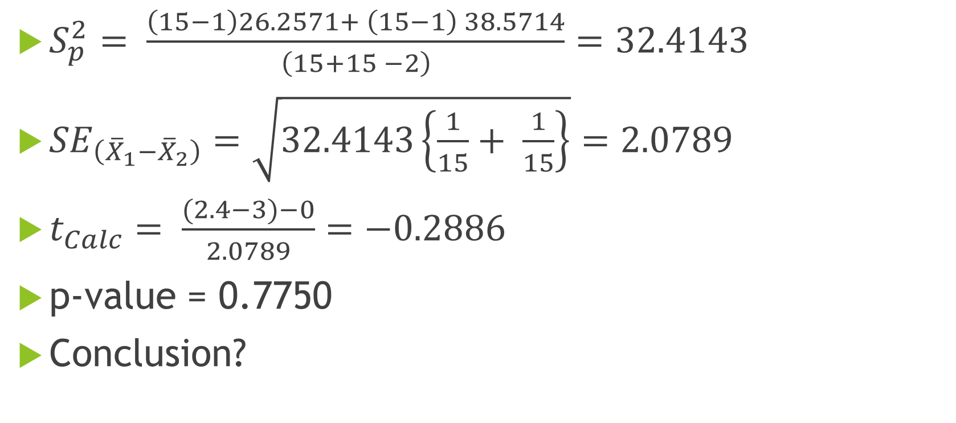
Hypothesis Test
$S_{p}^{2}= \frac{\left(15−1\right)26.2571+ \left(15−1\right) 38.5714}{\left(15+15 −2\right)}=32.4143$
${SE}_{\left({\overline{X}}_{1}−{\overline{X}}_{2}\right)}=\sqrt{32.4143\left\{\frac{1}{15}+ \frac{1}{15}\right\}}=2.0789$
$t_{Calc}= \frac{(2.4−3)−0}{2.0789}=−0.2886$
p-value = 0.7750
Conclusion?

Slide 14
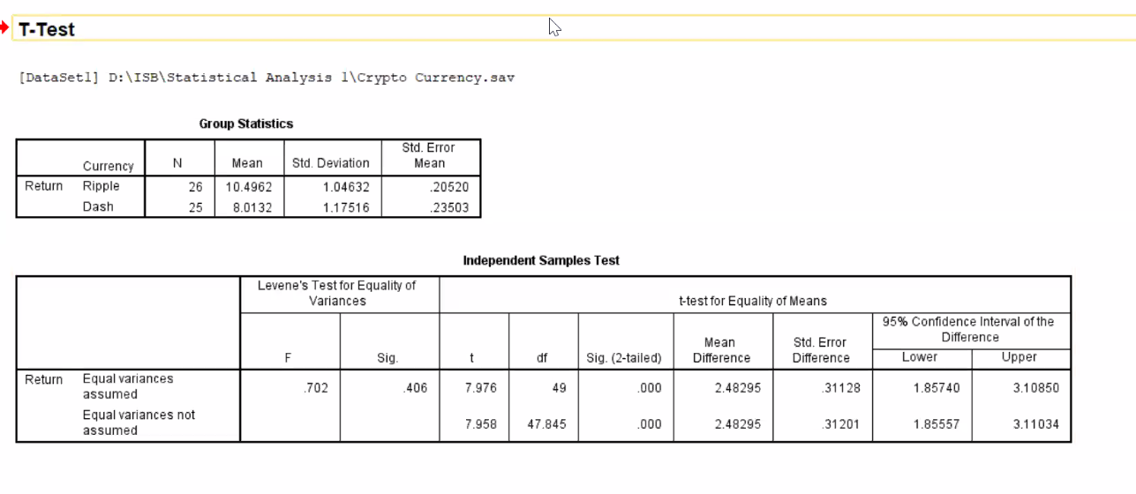
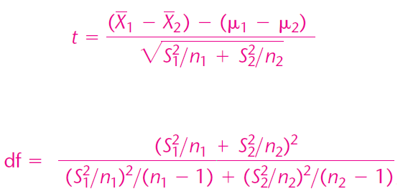
One More Scenario
σ₁ and σ₂ NOT known
And σ₁ ≠ σ₂
This is a complicated formula. All the software packages does these calculations and provide the data in tabular format. Attached SPSS Screen.

Slide 15
SPSS screenshot for performing Independent Samples Test

Slide 16
The Seven Point Advantage?
72 percent of our customers come back to ICL for repurchase
whereas only 65 percent of NSIS go back to NSIS for repurchases.
That is a full SEVEN percentage points more!

Slide 17

Hypothesis Test
Our original contention is this 7% difference is due to sampling variation. Thus H0 is π₁ - π₂ = 0.
H0: π₁ = π₂ ➔ π₁ - π₂ = 0
H1: π₁ ≠π₂ ➔ π₁ - π₂ ≠ 0
Estimator: (p₁ – p₂)
Distribution of (p₁ – p₂):
(p₁ – p₂) ~ N{(π₁ - π₂),$σ_{\left(p_{1} − p_{2}\right)}$}
$σ_{\left(p_{1} − p_{2}\right)}= \sqrt{\frac{π_{1}\left(1−π_{1}\right)}{n_{1}}+\frac{π_{2}\left(1−π_{2}\right)}{n_{2}}}$
If H₀ is true (π₁ = π₂ = π), $σ_{\left(p_{1} − p_{2}\right)}= \sqrt{π(1−π)(\frac{1}{n_{1}}+\frac{1}{n_{2}}})$
Since σ is a function of π itself we are not going for F distribution
Since our original contention that both the population proportions are same, we can replace π₁ = π₂ = π. Since p₁ and p₂ are estimating same π we need to combine them by doing a weighted average. Go to next slide.

Slide 18
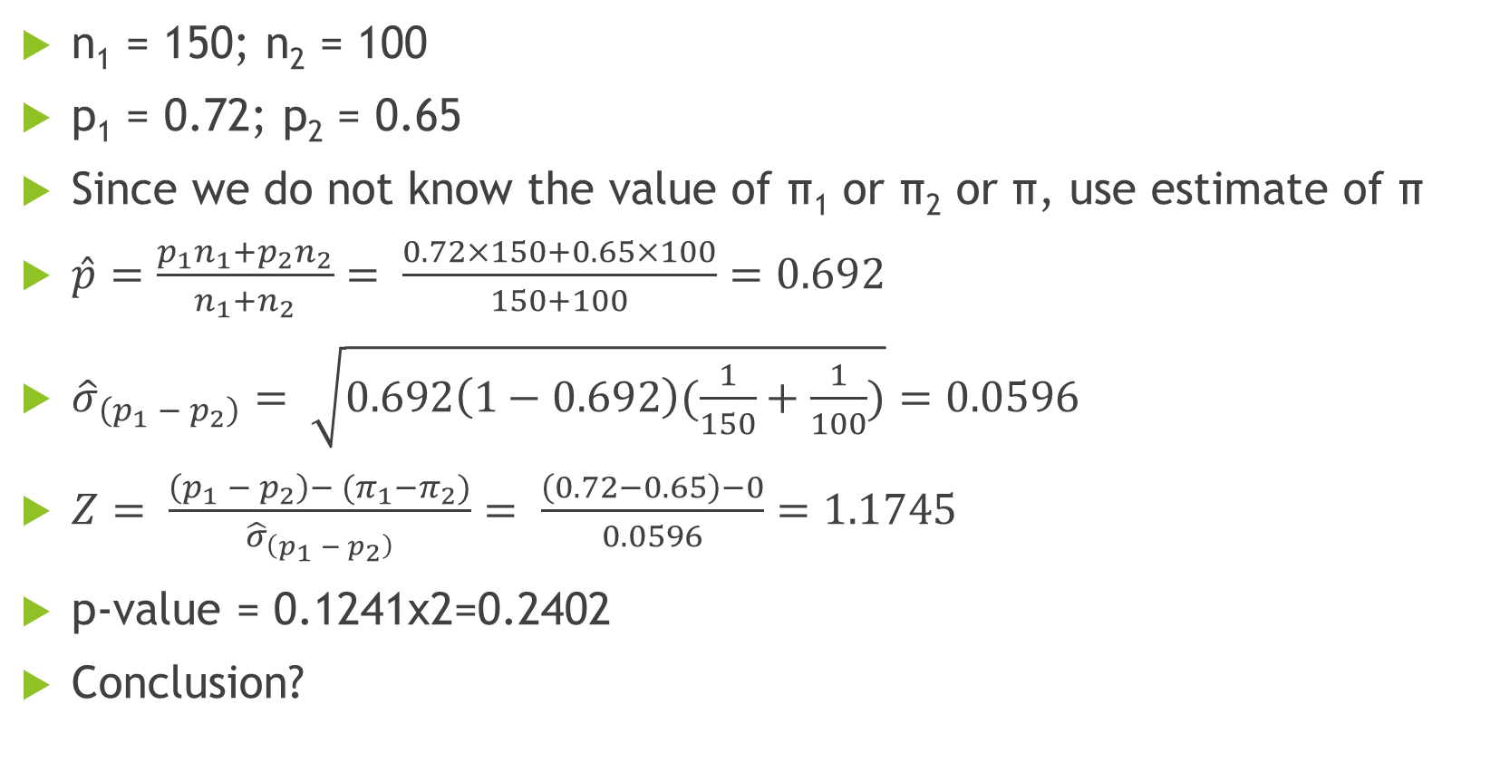
Basic Data
n₁ = 150; n₂ = 100
p₁ = 0.72; p₂ = 0.65
Since we do not know the value of π₁ or π₂ or π, use estimate of π
$\hat{p}=\frac{p_{1}n_{1}+p_{2}n_{2}}{n_{1}+n_{2}}= \frac{0.72×150+0.65×100}{150+100}=0.692$
${\hat{σ}}_{\left(p_{1} − p_{2}\right)}= \sqrt{0.692\left(1−0.692\right)(\frac{1}{150}+\frac{1}{100})}=0.0596$
$Z= \frac{\left(p_{1} − p_{2}\right)−{ (π}_{1}−π_{2})}{{\hat{σ}}_{\left(p_{1} − p_{2}\right)}}= \frac{\left(0.72−0.65\right)−0}{0.0596}=1.1745$
p-value = 0.1241x2=0.2402
Conclusion?
Why are we taking weighted average? It means irrespective of which company fraction of customers are returning back is being calculated here
Means this difference of 7% is due to sampling variation and not process variation. No reason to believe ICL is drawing more repurchase. If you take another sample you may end up getting -7% difference.

Slide 19
Questions?

